Slide 1


Relational Databases and SQL
18 Nov 15:00 - 17:00
25 Nov 15:00 - 17:00
2 Dec 15:00 - 17:00
9 Dec 15:00 - 17:00
16 Dec 15:00 - 17:00

Slide 2



@EdCDCS
For all events, news, and support: cdcs.ed.ac.uk

Slide 3
Relational Databases and SQL Structure of the course
First part: Today and next week: Module 1- Relational Database theory
Reference video course: https://www.linkedin.com/learning/learning-relational-databases-2/welcome?u=50251009
Structure of the module: Video watching and Q and A
Troubleshooting (last 15-20 mins)
Second part: Module 2- Essential SQL
Reference video course:https://www.linkedin.com/learning/sql-essential-training-2/installing-on-windows-part-i?u=50251009
Structure of the module: Viedeo watching, Q and A, exercises
Troubleshooting (last 15-20 mins)

Slide 4
Relational Databases and SQL: Structure of the course
AIMS of this training: Module 1- Relational Database theory
Basics of relational database design
Learn how to prevent data anomalies
Requirements to plan your design
develop a conceptual data model—translating your ideas into components like tables, relationships, queries, and views.
Logical design considerations that can help you construct a database that is easy to maintain.

Slide 5
Relational Databases and SQL: Structure of the course
AIMS of this training: Module 2- Essential SQL
creating tables
defining relationships
manipulating strings, numbers, and dates
using triggers to automate actions
using sub-selects and views.
building a simple and complete database application using SQL.

Slide 6

Relational Databases and SQL
Who are we?
Why are we here?
Which type of data do you work with?

Slide 7
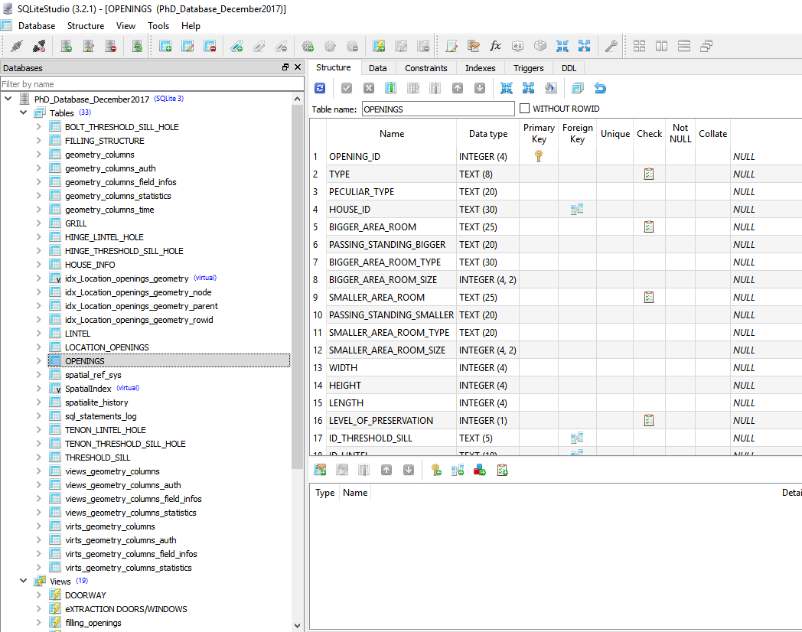
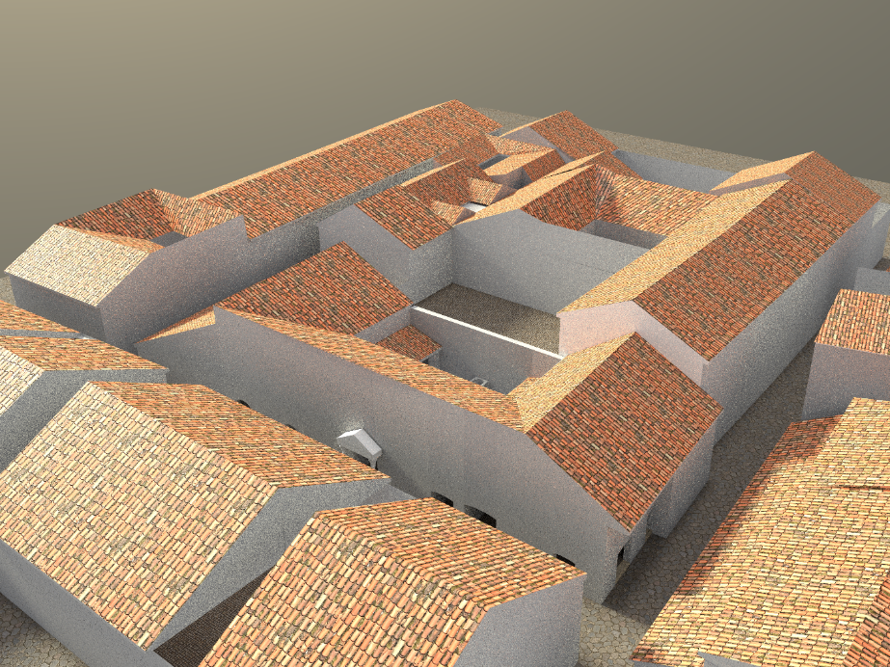
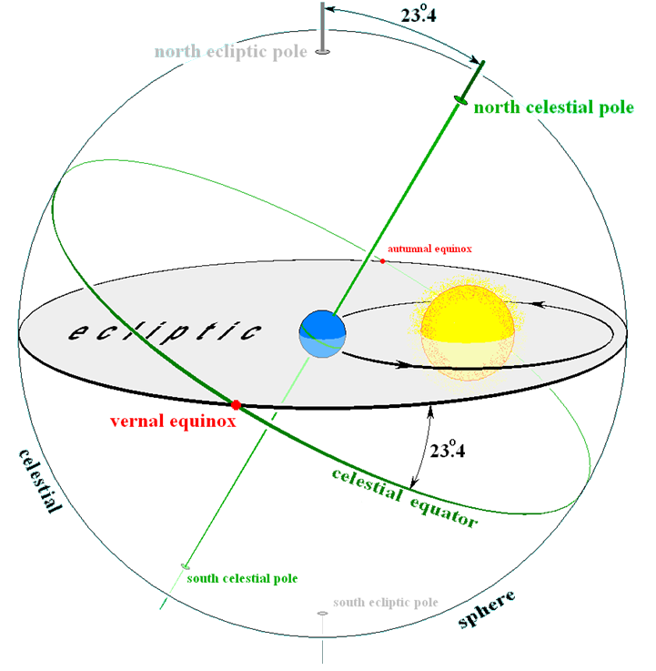

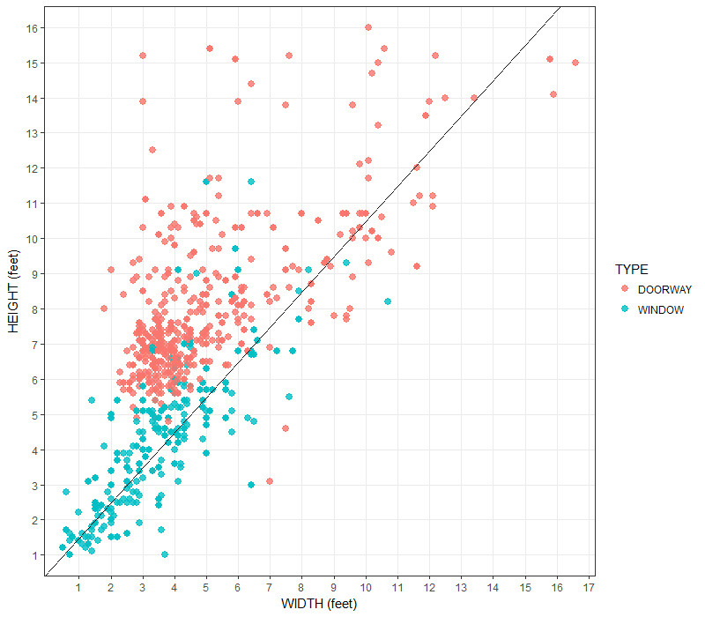
Before starting …
Who am I
I obtained a Phd in Classic from UEd
Training Fellow with DCS

Slide 8
Today program
Relational Database Basics
Prevent data anomalies
Gathering requirement
Developing conceptual data model

Slide 9
Relational Database Basics
Relational Database Basics
Relational structures
Understanding the RDBMS options
Life cycle of DB development
https://www.linkedin.com/learning/learning-relational-databases-2/database-management-systems-dbms?u=50251009

Slide 10
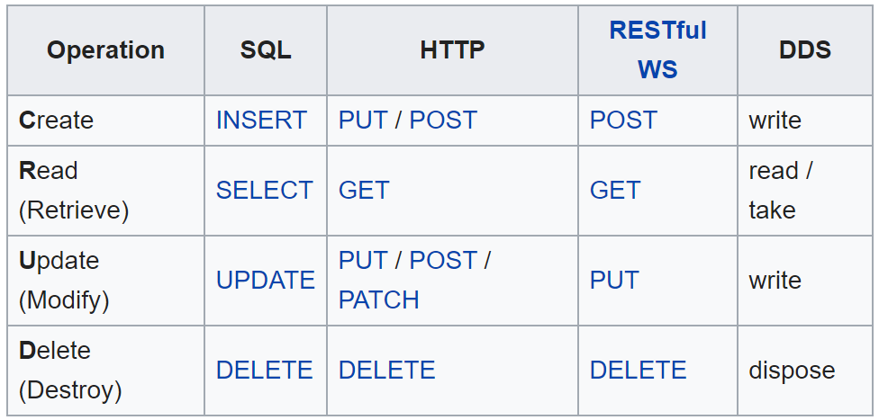
CRUD TASKS
a)

Slide 11
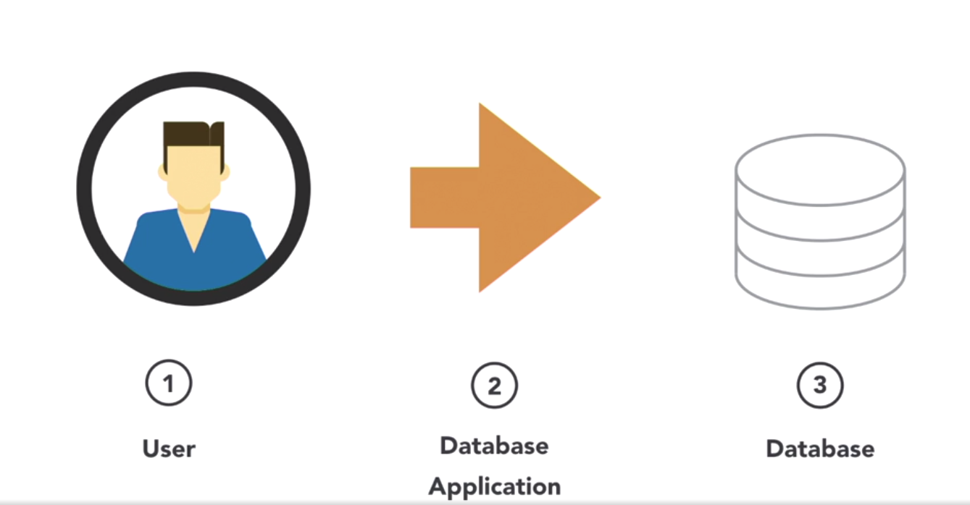
FRONT END
a)

Slide 12
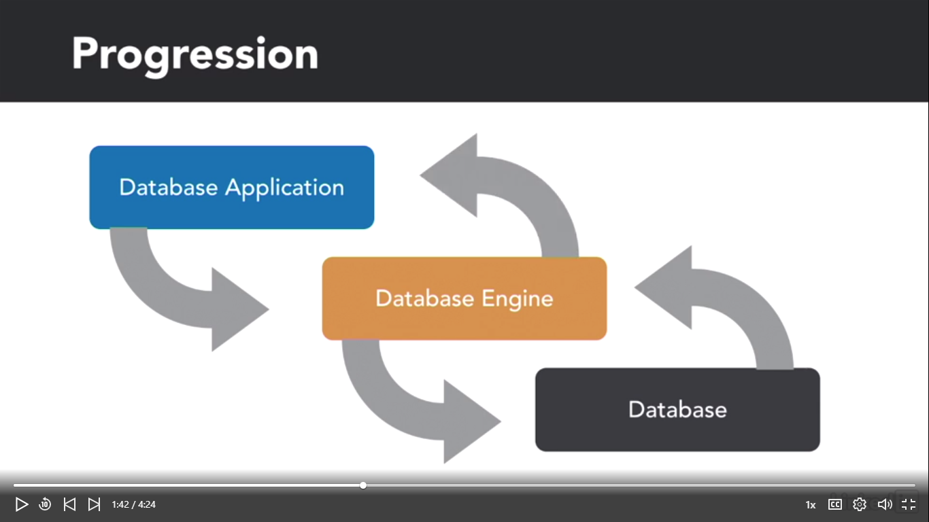
DBMS components
a)

Slide 13
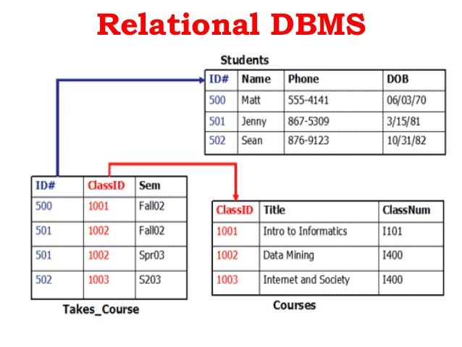
Relational DBMS
a)

Slide 14
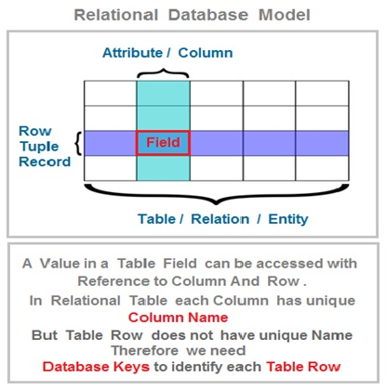
Relational DBMS: Table, columns, row and record
b)

Slide 15

Rules of Relation/Tables
b)
Cell must have a single value (ATOMIC)
Column must retrive one single type of info
Column name must be unique
Order is insignificant
Rows are unique

Slide 16
Server vs Desktop Applications
c)
SERVER
My SQL
PostgreeSQL
Oracle
DB2
Microsoft SQL server
DESKTOP
Access
Base
SQLite

Slide 17
What is SQL
c)
SQL: Structured Query Language is a domain-specific language used in programming and designed for managing data held in a relational database management system (RDBMS), or for stream processing in a relational data stream management system (RDSMS). It is particularly useful in handling structured data, i.e. data incorporating relations among entities and variables.
From Wikipedia

Slide 18
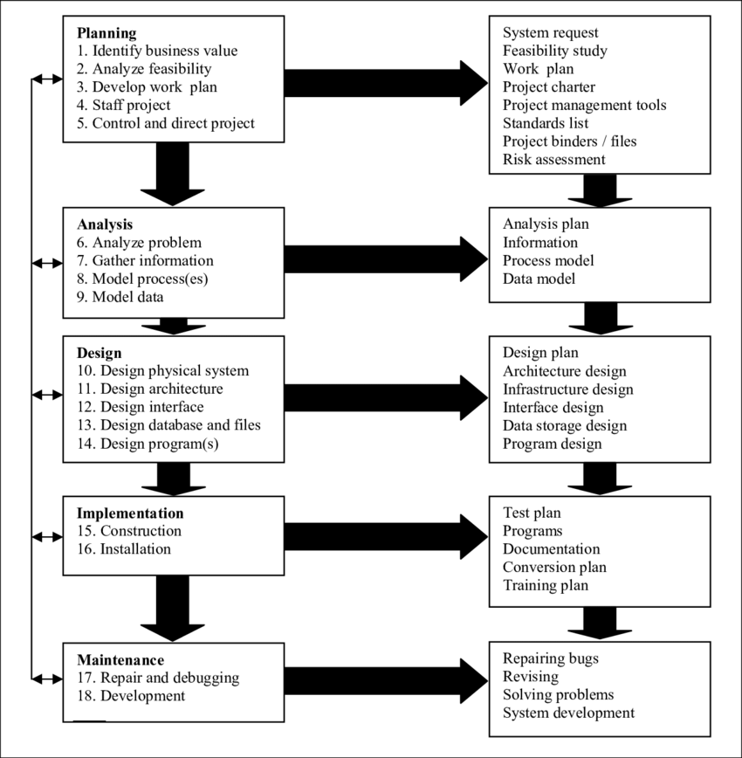
Life Cycle of DB development

Slide 19
Preventing data anomalies
Relational Database advantages
Remove duplicate information
Eliminate inconsistent data
Break data into its components
Prevent data conflicts
Require complete information
Maintain a consistent structure
https://www.linkedin.com/learning/learning-relational-databases-2/relational-database-advantages?u=50251009

Slide 20

Duplicate data problems
Avoid any possible problem by avoid redundancy

Slide 21
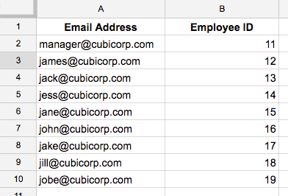
Eliminating inconsistent data
Use unique identifier! Or let the DB do it

Slide 22
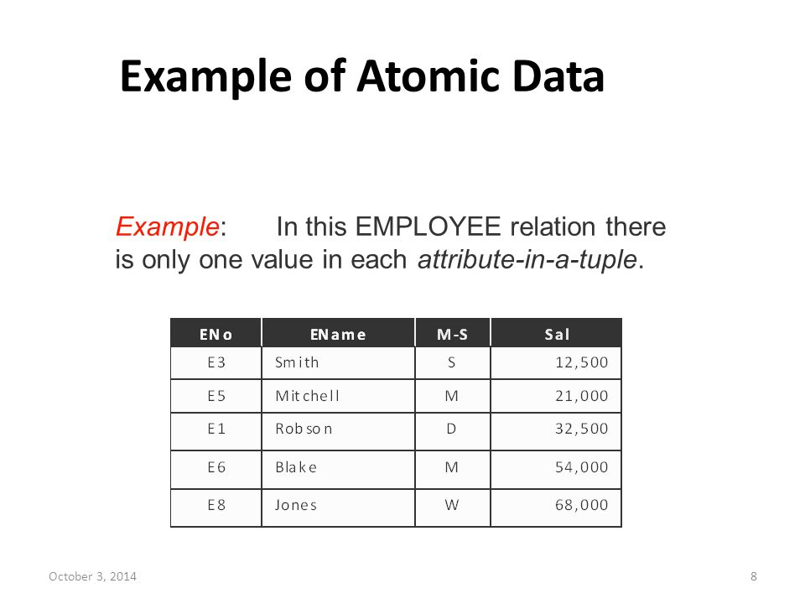
Break down data into its components
Break down your information into an atomic form

Slide 23

Prevent data conflict
Everything that can vary can be computed on the spot to avoid data conflict using calculators.
Let the Computer do the work for you!

Slide 24

Require complete information
Think well to which part of the info you are collecting cannot be null and which you wish to be able to leave empty

Slide 25
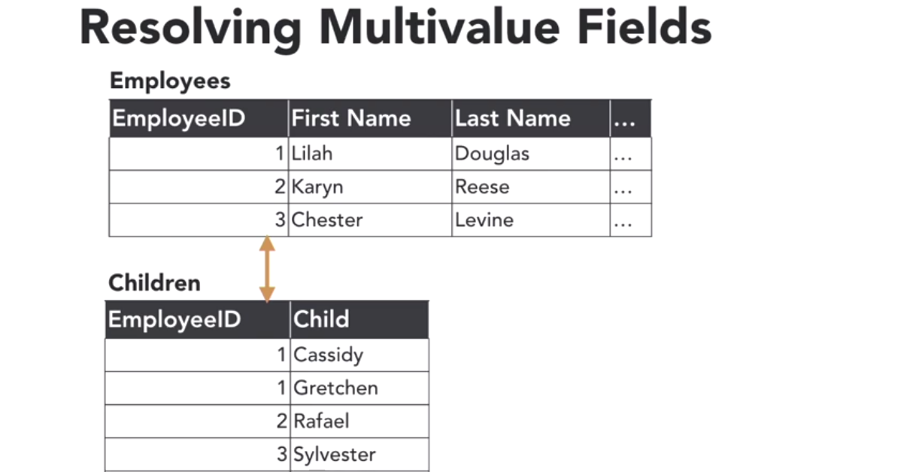
Maintain consistent structure
Horizontally vs vertically development

Slide 26
Gathering requirements
Understand the Goal
Review the current system
Discover actor and tasks
Interview the client
Work with historical values
Identify exceptions and irregularities
https://www.linkedin.com/learning/learning-relational-databases-2/understand-the-goal?u=50251009

Slide 27

Write down your mission objectives
List all the task that the DB will have to fullfil
E.g. I need to be able to see x information about this type of material
What I need to know about this type of data (journal, ceramics, glass, stone etc..)

Slide 28
Identify your mission and goal
Identify what your database is supposed to do and which answer you want to get from it
Identify what you need to do to achieve these goals
Create a mission statement of what the DB need to do

Slide 29
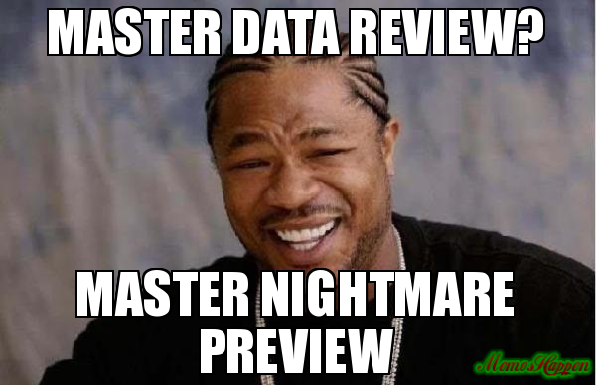
Review current system
Understand how the data are currently stored and the area that can be implemented better
Understand how your data look like and how can you uniform them

Slide 30

Actors and tasks
Identify who will use the DB and what they will need from it
Identify the task that this/these actor/s will have to perform within the DB (this will help you with setting privileges afterwards)

Slide 31

Interview the Client or yourself if it is your DB
General and specific questions
Identify the need and constraints that each portion of the DB will have to fulfill
Identify buisness rules e.g.
Phone numbers must include the area code
Zip code must allow internation address
Proveniance of pottery can be unkonw
Journal can have issue and number and need to be registered separately etc..

Slide 32
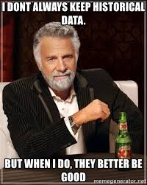
Deal with historical data
How do I store all those data that changed and are nowadays not updated anymore?
Eg. Changes of prices, changes of address etc..
Understand what need to be stored and how (normally by adding a column to the table)

Slide 33

Exception and irregularities
Identify and manage possible irregular and exeption data
What need to be uniformise and what cannot and need to be stored as an exeption and how

Slide 34
Developing the Conceptual data model
Understand entries and tables
Develop relationship
Develop subtypes and supertypes
Use lookup tables
Draft the initial data model
https://www.linkedin.com/learning/learning-relational-databases-2/understand-entities-and-tables?u=50251009

Slide 35
Data model

Slide 36

Define your tables and connection
Use what ever is easier for you but do not get too carry away you can always modify afterwards!!!

Slide 37
Identify relationships
How are you data related one to the other
Identify which column can link the 2 tables (identify unique identifiers)
Cardinality
1 to 1
1 to N
N to N
Optionality
1..
0..

Slide 38
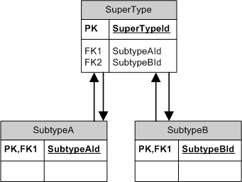
Create Subtypes and Supertypes
A supertype is a generic entity type that has a relationship with one or more subtypes. A subtype is a sub-grouping of the entities in an entity type that is meaningful to the organization and that shares common attributes or relationships distinct from other subgroups.

Slide 39
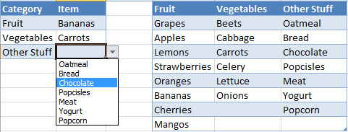
Lookup table
Lookup table. An array or matrix of data that contains items that are searched. Lookup tables may be arranged as key-value pairs, where the keys are the data items being searched (looked up) and the values are either the actual data or pointers to where the data are located.

Slide 40
Normalising your data
Identify key fields
First normal form
Second normal form
Third normal form
Denormalisation
https://www.linkedin.com/learning/learning-relational-databases-2/identify-key-fields?u=50251009

Slide 41

Identify Key field
For each table identify the unique identifier of a row – that value would be your primary key
Primary Key rules
Must be unique
Cannot be left blank
Must be filled when the record is created
Value cannot change

Slide 42
Types of primary keys and foreign key
Primary Key type
Natural (one field in your table can work as PK)
Surrogate (additional field normaly autopopulated by your DB)
Composed (combination of 2 or more field)
Foreing Key – correspondent key on the satellite table

Slide 43

First normal form
A relation is in first normal form if and only if the domain of each attribute contains only atomic (indivisible) values, and the value of each attribute contains only a single value from that domain.
Not name and surname but only name e.g.

Slide 44
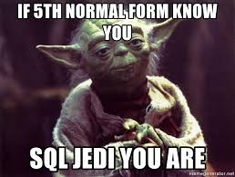
Second normal form
A relation is in the second normal form if it fulfills the following two requirements:
It is in first normal form.
All the fields in the primary key are required to determine the other non-key fields
Put simply, a relation is in 2NF if it is in 1NF and every non-prime attribute of the relation is dependent on the whole of every candidate key.

Slide 45

Third normal form
The entity is in second normal form.
No non-key attribute is transitively dependent on any key i.e.: no non-key attribute depends on other non-key attributes. All the non-key attributes must depend only on the primary keys.
3NF was designed to:
eliminate undesirable data anomalies;
reduce the need for restructuring over time;
make the data model more informative;
make the data model neutral to different kinds of query statistics.

Slide 46
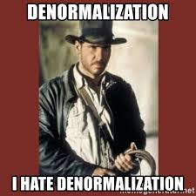
Denormalisation
Why?
Performance
Historical Data

Slide 47
Logical Design Considerations
Following naming convention
Data type and precision
Create junction tables
Apply integrity constraints
Enforce referential integrity
Build indexes
https://www.linkedin.com/learning/learning-relational-databases-2/identify-key-fields?u=50251009

Slide 48
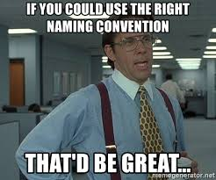
Following naming convention
Basically start creating your metadata
Document structure of your DB
Helps other and your future self what and why have you done
Aids the addition of new features
Check if there are standard in your field (e.g. pottery names)

Slide 49
Following naming convention
Rules
Be consistent (mostly with uppercase, lowercase and underscore uses)
Do not use special carachters (!»£$&* etc also space is a special c.)
Know the reserved words (words that mean certain function in your RDBMS such as: select, create, date, time, min, max, name etc…)

Slide 50
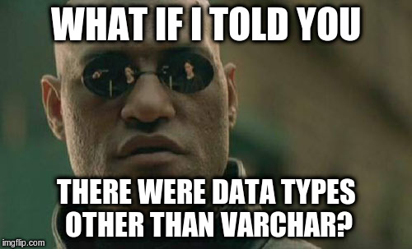
Data type and precision
String text data
Short (varchar normally top 50)
Long (CLOB for paragraph of text)
Also number can be stored as text e.g. phone number.
Numeric (anything you can do math on)
Exact number (Integer, decimal etc.)
Approximate number (Float, real etc.)
Bolean (yes or no)
Additional data type (e.g. Date, Time stamp etc.)
N.B. All the name depend on the software used!!!

Slide 51
Data type and precision
Data type | Description
CHARACTER(n) | Character string. Fixed-length n
VARCHAR(n) or CHARACTER VARYING(n) | Character string. Variable length. Maximum length n
BINARY(n) | Binary string. Fixed-length n
BOOLEAN | Stores TRUE or FALSE values
VARBINARY(n) or BINARY VARYING(n) | Binary string. Variable length. Maximum length n
INTEGER(p) | Integer numerical (no decimal).
SMALLINT | Integer numerical (no decimal).
INTEGER | Integer numerical (no decimal).
BIGINT | Integer numerical (no decimal).
DECIMAL(p,s) | Exact numerical, precision p, scale s.
NUMERIC(p,s) | Exact numerical, precision p, scale s. (Same as DECIMAL)
FLOAT | Approximate numerical
DOUBLE PRECISION | Approximate numerical
DATE | Stores year, month, and day values
TIME | Stores hour, minute, and second values
TIMESTAMP | Stores year, month, day, hour, minute, and second values
INTERVAL | Composed of a number of integer fields, representing a period of time, depending on the type of interval
ARRAY | A set-length and ordered collection of elements
MULTISET | A variable-length and unordered collection of elements
XML | Stores XML data

Slide 52

Create junction tables
An associative (or junction) table maps two or more tables together by referencing the primary keys of each data table. In effect, it contains a number of foreign keys, each in a many-to-one relationship from the junction table to the individual data tables.

Slide 53
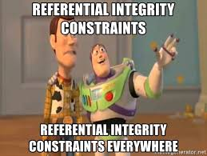
Apply integrity constraints
Integrity constraints are a set of rules. It is used to maintain the quality of information. Integrity constraints ensure that the data insertion, updating, and other processes have to be performed in such a way that data integrity is not affected.
Number range
Acceptable values
Not null

Slide 54
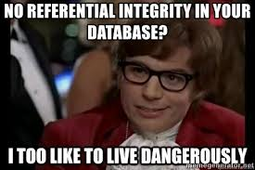
Enforce referential integrity
Referential integrity (RI) is a relational database concept, which states that table relationships must always be consistent. In other words, any foreign key field must agree with the primary key that is referenced by the foreign key.

Slide 55
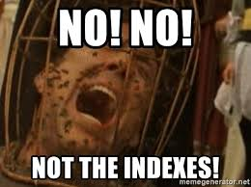
Build indexes
A database index is a data structure that improves the speed of data retrieval operations on a database table at the cost of additional writes and storage space to maintain the index data structure. Indexes are used to quickly locate data without having to search every row in a database table every time a database table is accessed.

Slide 56
SQL installation Troubleshooting
Do you have the exercise files downloaded? and Nano ++ Editor or Bb edit correctly installed?
Is Xampp installed and working correctly?

Slide 57
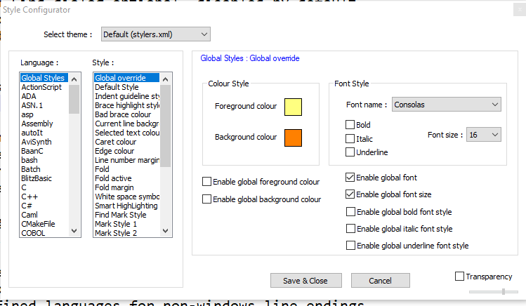
Settings in Nano ++
Open as adiministrator
Go to Settings > Preferences >Costumize
Enter .txt, .php, .sql, .html, .htm, .css
Go to settings > Style configurator

Slide 58

Settings in Notepad ++
Go to settings > Preferences > set space instead of Tab under Languages
Go on the chapter folder and select Nano ++ as default program

Slide 59
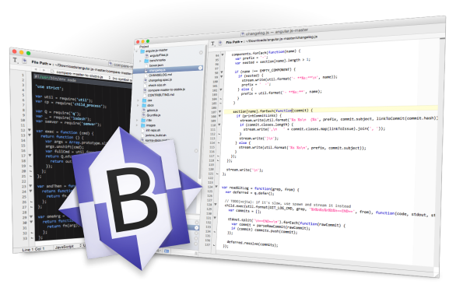
Settings in Bbedit
Go to preferences and set colour and size of the font
Go on the chapter folder and select Notepad ++ as default program

Slide 60

Xampp Installation
XAMPP is a free and open-source cross-platform web server solution stack package developed by Apache Friends, consisting mainly of the Apache HTTP Server, MariaDB database, and interpreters for scripts written in the PHP and Perl programming languages. Since most actual web server deployments use the same components as XAMPP, it makes transitioning from a local test server to a live server possible.

Slide 61
Xampp Installation
Before installing it check other web server are not in use: go to Control Panel > Programs > Turn windows features on off> unchecked internet information…
Download the right version of Xampp from here https://bw.org/ldcsql/
Add the Xamp control panel to your bar and Start Apache
Crt c Crt v CRUD Db and SID folders from the exercise folder to C:\xampp\htdocs
Run in your browser http://localhost/sid/sid.php and http://localhost/crud/crud.php and drag and drop them to the favorites
Test a query on SID
For Mac check you have read and write permission on DBs

Slide 62
SQL overview
CURD and the SELECT statement
DB organization
The SELECT statement
Selecting Rows
Selecting Columns
Counting Rows
Inserting Data
Updating Data
Deleting Data

Slide 63
CRUD TASKS

Slide 64
DB organization
Concept to remember
Relational Database
Table
Column
Row
Record
Primary an external key

Slide 65
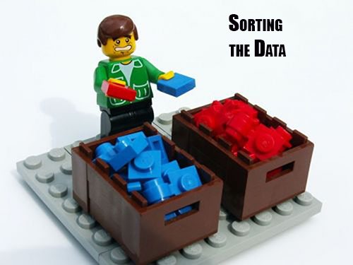
The Select Clause
SELECT (what do we want to see)
FROM (in which table this info is stored)
AS (How I want to call my result)
ORDER BY (which column I want to use to order my results

Slide 66

Select Rows
SELECT (what do we want to see)
FROM (in which table this info is stored)
WHERE or LIMIT (control the results)

Slide 67
Select Column
SELECT (Name of the columns I want separated by a comma)
FROM (in which table this info is stored)

Slide 68

Counting Rows
SELECT COUNT (* or a specific column) (counts how many rows
FROM (in which table this info is stored)

Slide 69

Adding Rows
INSERT INTO Table name (Which columns separated by a comma and between single quotes)
VALUES (Values you want to enter between single quotes and separated by a comma);

Slide 70

Change Rows
UPDATE Table name
SET column1 = ‘new value’, column2 = ‘new value’
WHERE Primary key = the row with the value I want to change;

Slide 71

Delete Data
DELETE FROM Table Name
WHERE Primary key = the row with the value I want to change;

Slide 72
SQL Fundamental Concepts
Creating a Table
Deleting a Table
Inserting a Row
Deleting a Row
The NULL value
Constraing Columns
Changing a Scheme
ID Columns
Filtering Data
Removing Duplicates
Ordering Output
Conditional Expressions

Slide 73
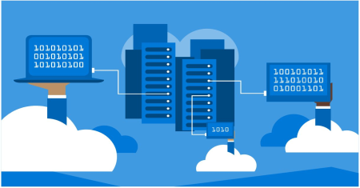
Create a Table
CREATE TABLE name of the table (
Comun1name INTEGER (type of data),
Comun2name TEXT (type of data),
etc..
);
INSERT INTO name of the table VALUES ( ‘Value in column 1’, ' Value in column 2 ' );

Slide 74
Delete a Table
DROP TABLE Name of the Table;
DROP TABLE IF EXISTS Name of the Table; (To avoid errors)

Slide 75
Inserting and Deleting a row
INSERT INTO Table Name (I can specify between brackets in which columns)
VALUES ( ‘Value in column 1’, ' Value in column 2 ' );
DELETE FROM Table Name
WHERE Primary key = the row with the value I want to change;

Slide 76

The NULL value
SELECT FROM Table Name
WHERE Column IS NULL/ IS NOT NULL;
NB NULL is different than 0 and empty string

Slide 77

Constraining Columns
Use default values when needed instead of NULL
CREATE TABLE Table name ( Column1 TEXT UNIQUE, Column2 TEXT, Column3 TEXT DEFAULT 'panda' );
Common Constrains:
UNIQUE
NO NULL
DEFAULT ‘ ’

Slide 78

Changing a Schema
ALTER TABLE Table Name
ADD New Column TEXT (Type);
If I want default instead of NULL:
ADD New Column TEXT DEFAULT ‘something';

Slide 79

ID Columns
How to Create an automatically populated Primary key
CREATE TABLE Table name
( PrimaryKey column INTEGER PRIMARY KEY, a INTEGER, b TEXT);
INSERT INTO Table name (Column2, Column3) VALUES ( 10, 'a’ );
The system will automatically fill the Primary key Column

Slide 80
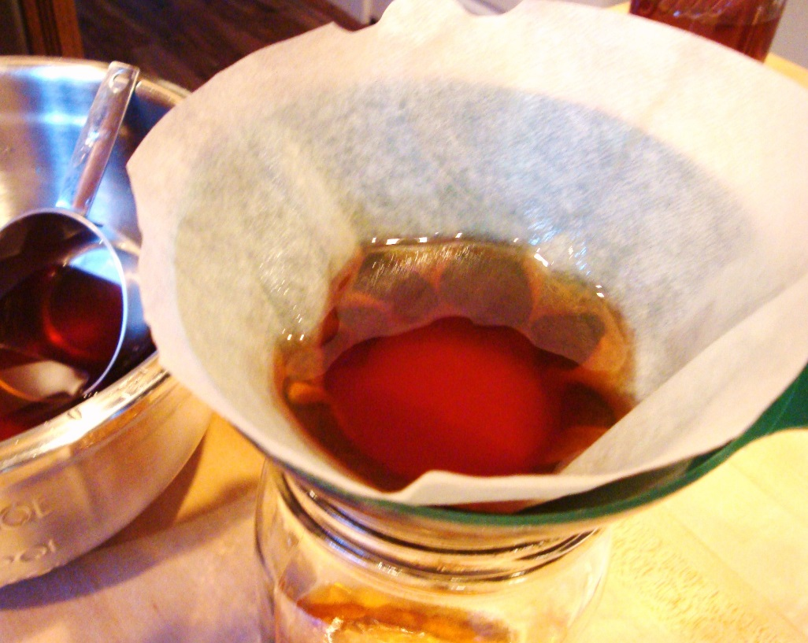
Filtering Data
SELECT columns
FROM Table Name
WHERE column < of something OR / AND column IS NULL (o IN (‘some’, ‘some’ ) if you have a list)
ORDER BY column DESC/ASC;
You also can use the LIKE operator
LIKE ‘%something%'
Contain what is between %%

Slide 81

Select Distinct
Unique values
Single occurrences of one value or a combination of values
SELECT DISTINCT Column
FROM Table;

Slide 82
Ordering Output
Sorting
We can also sort the results of our queries
How do we want our data to be displayed
SELECT column/s
FROM Table
ORDER BY column DESC/ASC, column2 etc…

Slide 83
Joins
Understanding Joins
Accessing related tables
Relating multiple tables
https://www.linkedin.com/learning/sql-essential-training-2018/understanding-join?u=50251009

Slide 84

Type of Joins

Slide 85
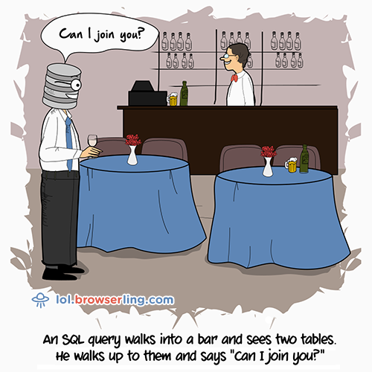
Simple inner join
SELECT tablename1.Columnname1, tablename1.Columnname2, tablename2.Columnname1
FROM tablename1
JOIN tablename2 ON tablename1.id = tablename2.id

Slide 86
Left join
SELECT tablename1.Columnname1, tablename1.Columnname2, tablename2.Columnname1, tablename2.Columnname2
FROM tablename1
LEFT JOIN tablename2 ON tablename2 ON tablename1.id = tablename2.id
Will Give you all the record of table 1 and add null values where no result in table 2

Slide 87
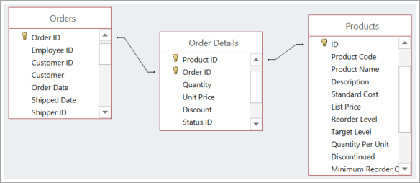
Multiple joins
SELECT tablename1.Columnname1, tablename1.Columnname2, tablename2.Columnname1, tablename3.Columnname1 etc…
FROM tablename1
JOIN tablename2 ON tablename1.id = tablename2.id
JOIN tablename3 ON tablename1.id = tablename3.id
3
2
1
If you have many to many related tables and you have a middle table to fix it you shall use the middle table as base for the Join
In this case table 1 is the middle table between table 2 and table 3

Slide 88
Strings
About SQL strings
Finding the length of a string
Selecting part of a string
Removing Spaces
Folding case
https://www.linkedin.com/learning/sql-essential-training-2018/about-sql-strings?u=50251009

Slide 89
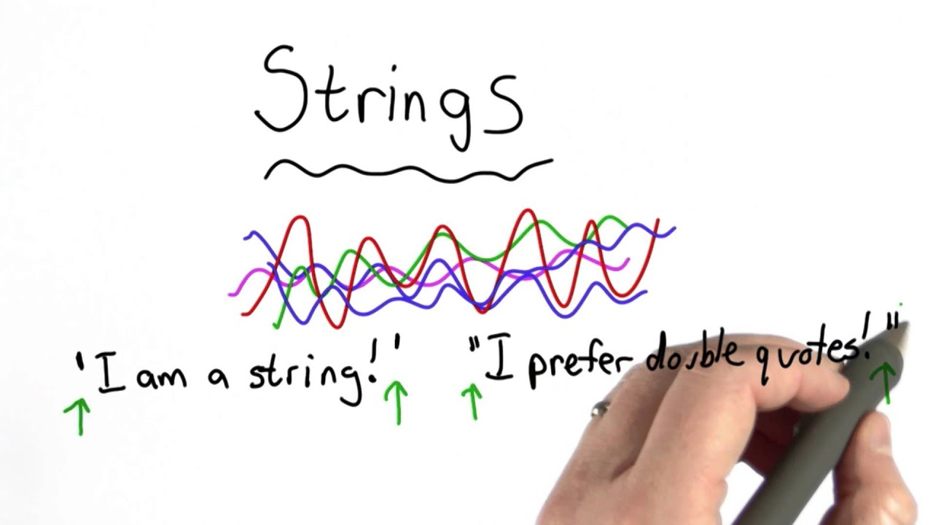
Strings
“A string is a series of characters delimited by quotation mark present in the database”

Slide 90
Finding length of a string
SELECT column LENGTH (column) AS Len
FROM table
ORDER BY Len DESC, column;

Slide 91
Finding length of a string
SELECT column LENGTH (column) AS Len
FROM table
ORDER BY Len DESC, column;

Slide 92
Select part of a string
SELECT SUBSTR (‘this is my string’, from which carachter)
Extract information from not atomic column e.g. transform a date column into Year, Month, Day columns

Slide 93
Removing spaces
SELECT TRIM (‘string’)
SELECT LTRIM (‘string’)
SELECT RTRIM (‘string’)
SELECT TRIM (‘string’, ‘the value I want to trim)

Slide 94
Folding cases
SELECT UPPER (column);
NB it change only ASCII characters so not special and accented ones

Slide 95
Numbers
Numeric types
Identify type of value
Rounding numbers
https://www.linkedin.com/learning/sql-essential-training-2018/numeric-types?u=50251009

Slide 96

Numeric Types
INTEGER Types
INTEGER (precision)
DECIMAL (precision, scale)
MONEY (precision, scale)
REAL Types
REAL (precision)
FLOAT (precision)

Slide 97
Identify type of values
SELECT TYPEOF (My calculation)
FROM table;

Slide 98
Rounding Numbers
SELECT ROUND(column, number of ciphers after the comma I want to have)

Slide 99
Dates and times
Dates and times
Dates and times functions
https://www.linkedin.com/learning/sql-essential-training-2018/dates-and-times?u=50251009

Slide 100
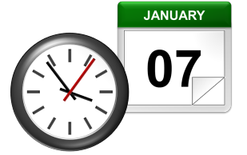
Dates and Times
In SQLite
SELECT DATETIME('now');
SELECT DATE('now');
SELECT TIME('now');
SELECT DATETIME('now', '+n day');
SELECT DATETIME('now', '+n days');
SELECT DATETIME('now', '-n month');
SELECT DATETIME('now', '+n year');
SELECT DATETIME('now', '+n hours', '+n minutes', '-n day', '+n years');
SQL standard representation:
Year-month-day hour:mins:seconds
All transformed to UTM time

Slide 101
Aggregates
What are aggregates?
Aggregate functions
Aggregate DISTINCT values
https://www.linkedin.com/learning/sql-essential-training-2018/what-are-aggregates?u=50251009

Slide 102
Aggregates
SELECT column,
COUNT(*)
FROM Country
GROUP BY column
HAVING (like where but for aggregate columns)
MIN | returns the smallest value in a given column
MAX | returns the largest value in a given column
SUM | returns the sum of the numeric values in a given column
AVG | returns the average value of a given column
COUNT | returns the total number of values in a given column
COUNT(*) | returns the number of rows in a table

Slide 103
Aggregates and DISINCT
SELECT COUNT(DISTINCT column)
FROM table;
Removing duplicates

Slide 104
Transactions
What are Transactions?
Data Integrity
Performance
https://www.linkedin.com/learning/sql-essential-training-2018/what-are-transactions?u=50251009

Slide 105
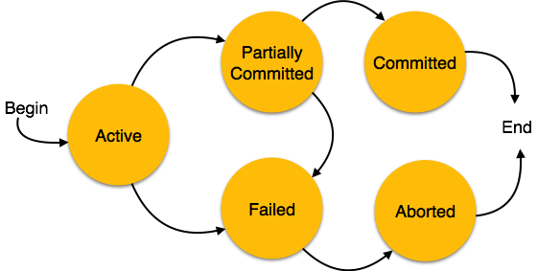
What are Transactions?
“In databases transactions are a series of concatenated operations handled as one unit of work. They are use to preserve DB consistency”
BEGIN TRANSACTION;
INSERT INTO Table ( Column1, Column2, Column3 ) VALUES ( a, b, c );
UPDATE Table SET column = ( column - n ) WHERE id = n;
END TRANSACTION;
When you have a lot of actions to perform using transaction will increase the DB performance

Slide 106
Triggers
Automating data with triggers
Preventing updates
Time stamps
https://www.linkedin.com/learning/sql-essential-training-2018/automating-data-with-triggers?u=50251009

Slide 107
Triggers
Trigger can be used to automatically update connected tables to reduce the data intro error chances
CREATE TRIGGER Name of the trigger AFTER INSERT ON name of the table you are updating (T1)
BEGIN
UPDATE table you want to update too (T2) SET column in (T2)to update = NEW.id WHERE T2id = NEW. External key in T1;
END

Slide 108
Triggers to prevent updates
CREATE TRIGGER Name of the trigger BEFORE UPDATE ON name of the table you are updating (T1)
BEGIN
SELECT RAISE (ROLLBACK, ‘cannot update table “name of my table “’) FROM Name of the table
WHERE id= NEW.id AND other column = given value;
END

Slide 109
Triggers and Time stamps
CREATE TRIGGER Name of the trigger AFTER INSERT ON name of the table you are updating (T1)
BEGIN
UPDATE T1 SET = DATETIME (‘now’) WHERE id= NEW.id;
UPDATE T2 SET = DATETIME (‘now’) WHERE id= NEW.id;
WHERE T2.id = NEW.id
INSERT INTO T3 (col1, col2, col3 etc) VALUES (use the values created by the previous triggers to fill log);
END

Slide 110
Views and Subselects
Creating a subselect
Searching within a result set
Creating a view
Creating a joined view
https://www.linkedin.com/learning/sql-essential-training-2018/creating-a-subselect?u=50251009

Slide 111
Creating a subselect
You can use the result of a substr to join an other table and create different outputs
SELECT SUBSTR (name column, n, to n) AS newcol1, SUBSTR (name colum, n, to n) AS newcol2, etc…
Use this to join a separate table

Slide 112
Search within results
You can use the result of a where clause to refine result of a separate table making the first where result the where clause of the second selection
SELECT * FROM table1
WHERE col1 IN (SELECT DISTINCT Table2Col1 FROM Table2 WHERE col2 is something)

Slide 113
Creating a view
If you are going to use the result of a query quite often you can save the result as a view
CREATE VIEW View name AS my query
It basically create a metastable
You can also create a view from the result of a join

Slide 114
Defined Functions
Define UDF
https://www.linkedin.com/learning/sql-essential-training-2018/overview?u=50251009

Slide 115
Crud Application
Embedding SQL
The SELECT functions
The INSERT, UPDATE, and DELETE functions
https://www.linkedin.com/learning/sql-essential-training-2018/embedding-sql?u=50251009

